Slide 1
AWS Athena

Slide 2
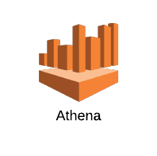

AWS DATABASES
2

Slide 3
Athena - Basics
Serverless interactive query service
PrestoDB (Facebook) implementation
Works on data stored in S3 (support for compression and encryption)
But is still quite fast
3

Slide 4
Athena - Basics
Uses Apache Hive Data definition language (DDL)
Supports ANSI SQL
Pay as you go model (like Lambda). Charges based on data scanned by the query. 5$ per TB of data scanned
No charge for creating tables
S3 costs are separate
4

Slide 5
Athena – Concepts
Tables - Metadata that describes your data similar to traditional database tables.
Tables are like views.
For e.g. You can delete table definitions without impacting the underlying S3 data
5

Slide 6
Athena – Concepts
Databases - Logical grouping of tables. (catalog or a namespace)
**SerDe** - Serializer/Deserializer - libraries that tell Hive how to interpret data formats.
Apache Web Logs, CSV, JSON, ORC (Optimized Row Columnar), Apache Parquet etc
Data can also be compressed in GZIP to save costs
Data can be partitioned with some formats to improve performance and save costs
6

Slide 7
Athena - Limitations
No support for transactions. This includes any transactions found in Hive or Presto. (When you create, update, or delete tables, those operations are guaranteed ACID-compliant.)
No support for stored procedures
7

Slide 8
Athena - Limitations
Limited to 2 AWS regions
You can use Athena to query underlying Amazon S3 bucket data that's in a different region
API/SDK support (Limited to JDBC driver)
8

Slide 9
Athena – Query Limitations
CREATE VIEW REVENUE0 (SUPPLIER_NO, TOTAL_REVENUE) AS SELECT ...
SELECT S_SUPPKEY, S_NAME FROM SUPPLIER, REVENUE0 WHERE ...
DROP VIEW REVENUE0
Vs
WITH REVENUE0 AS (SELECT ...) SELECT S_SUPPKEY, S_NAME FROM SUPPLIER REVENUE0 WHERE ...
9

Slide 10
Athena – Service Limits
Query timeout: 30 minutes
Number of databases: 100
Table: 100 per database
Number of partitions: 20k per table
S3 limits also impact it
10

Slide 11
Athena – Use Cases
Querying of any data in S3. If latency is not critical and queries can be run in the background
For e.g analyzing log data in S3
Integrating with AWS Glue (ETL)
11

Slide 12
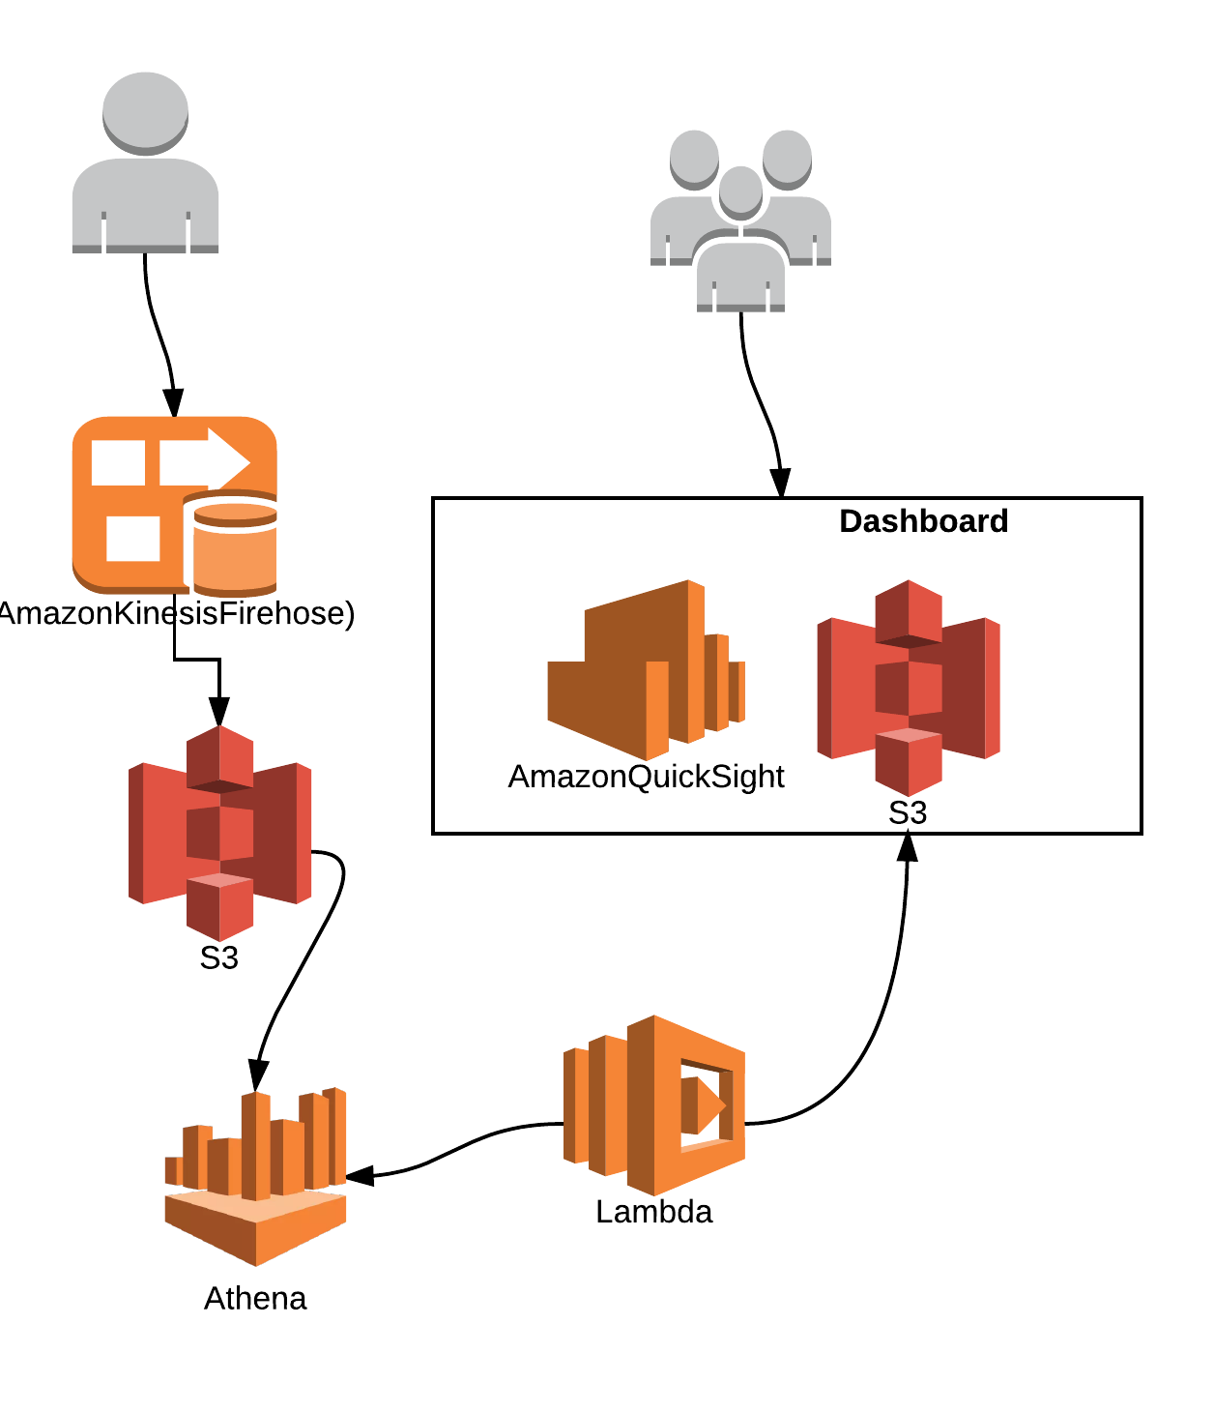
Athena – Use Cases
Go serverless across the stack. API gateway can be used to accept requests which are handled by Lambda which in turn can leverage Athena for queries. The only persistent service used will be S3.
12

Slide 13
Athena – Use Cases
Mix and match AWS services. Use an on-demand EMR cluster to process data and dump results to S3. Then use Athena to create adhoc tables and run reports.
Redshift Spectrum uses Athena behind the scenes for a hybrid model (Redshift local + Redshift S3)
13

Slide 14
Athena – Use Cases
“Facebook uses Presto for interactive queries against several internal data stores, including their 300PB data warehouse. Over 1,000 Facebook employees use Presto daily to run more than 30,000 queries that in total scan over a petabyte each per day”
14

Slide 15
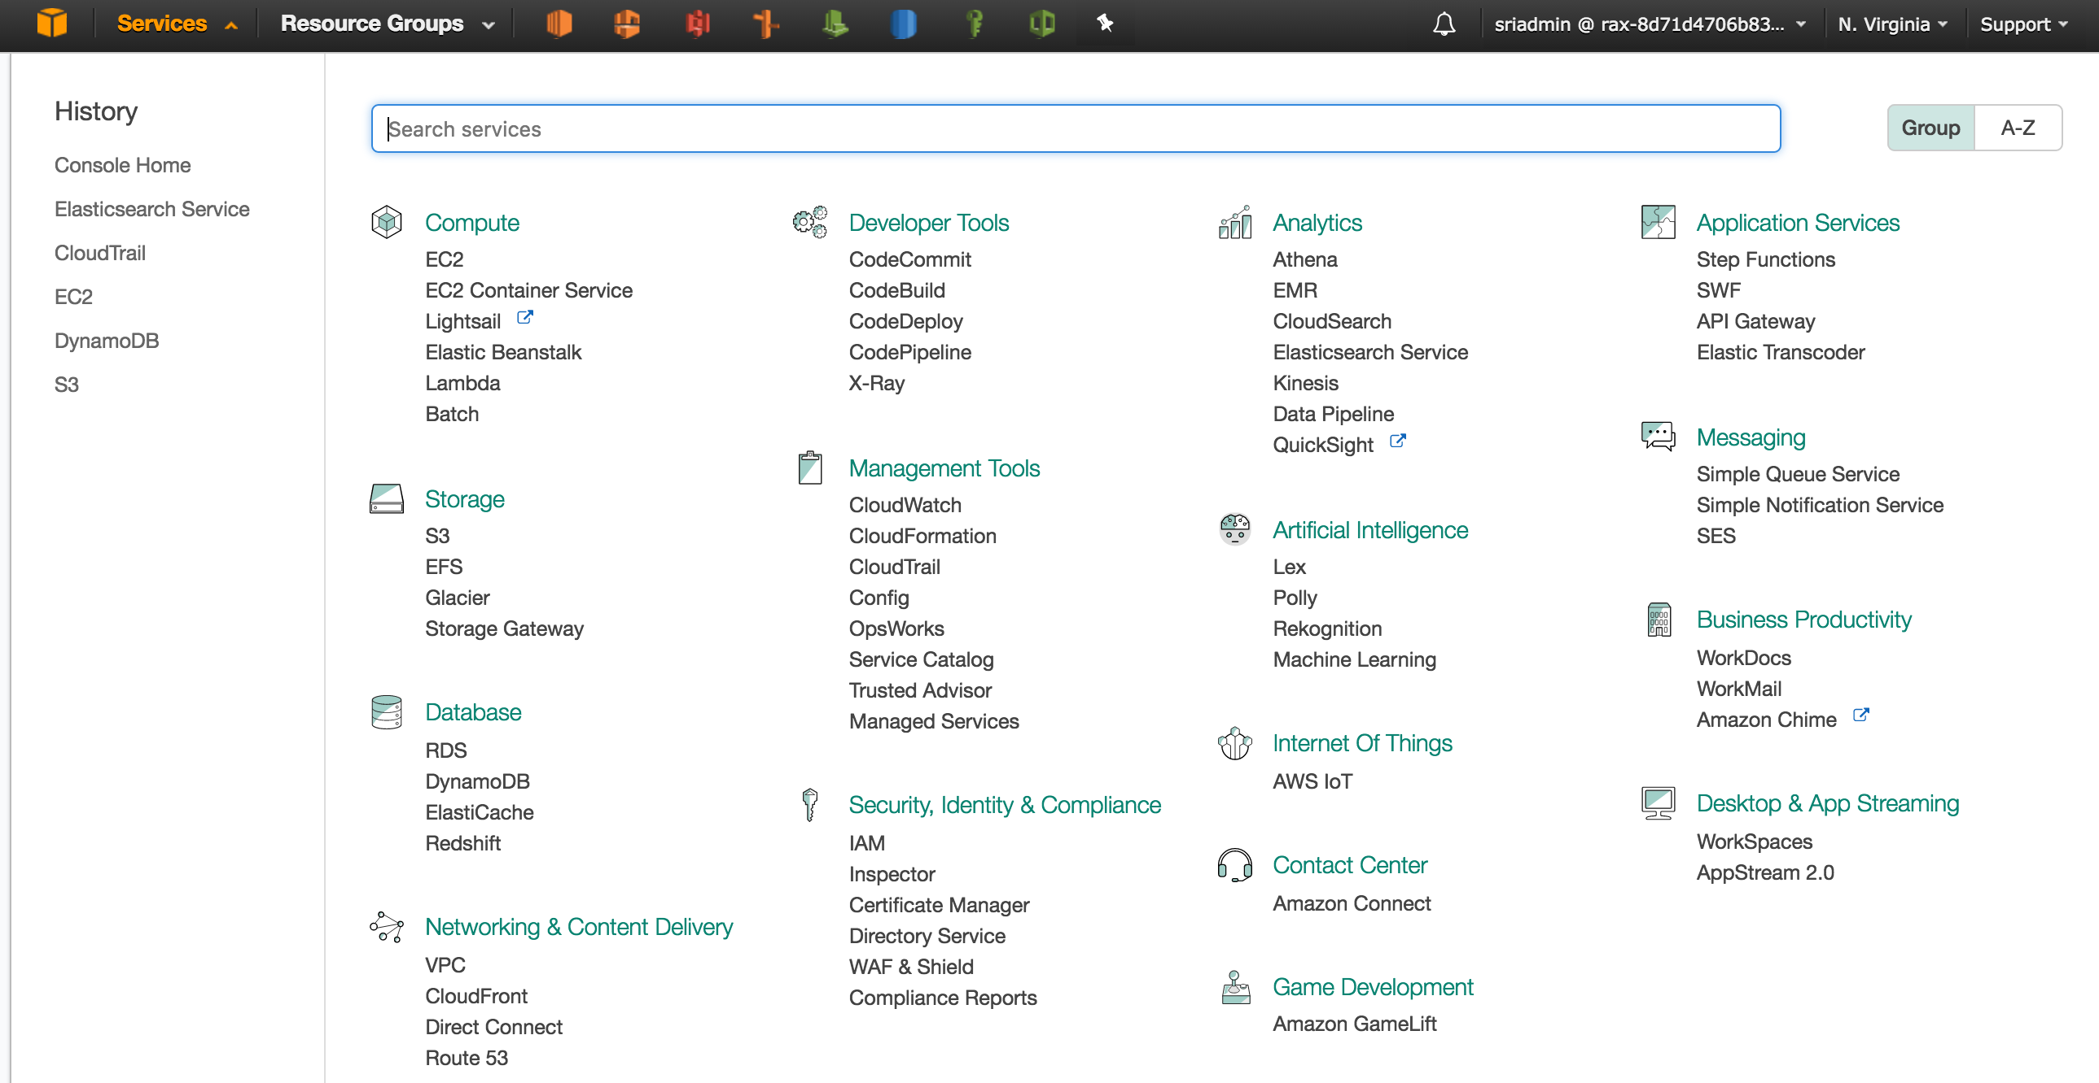
Athena – Demo
https://github.com/rackerlabs/athena-playground
15

Slide 16
https://rax.io/aws-ks
https://github.com/rackerlabs/athena-playground

